Slide 1
Airline Reservation Analysis
Mr. Sarvesh Pandit

Slide 2
Index
Objective
Creating Database
Creating Tables
Altering Tables
Inserting Values
Selecting Values
Query /Analysis

Slide 3
Objective
To design and implement a database-driven system that manages flights, passengers, bookings, and users efficiently, enabling airlines, agents, and administrators to handle reservations and related operations accurately.
Flight Management
Passenger Management
Booking Management
User & Role Management
Data Integrity and Security
Reporting & Analytics

Slide 4
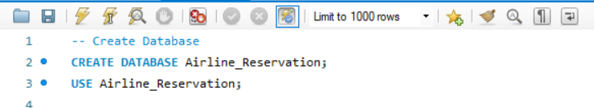
Creating Database

Slide 5
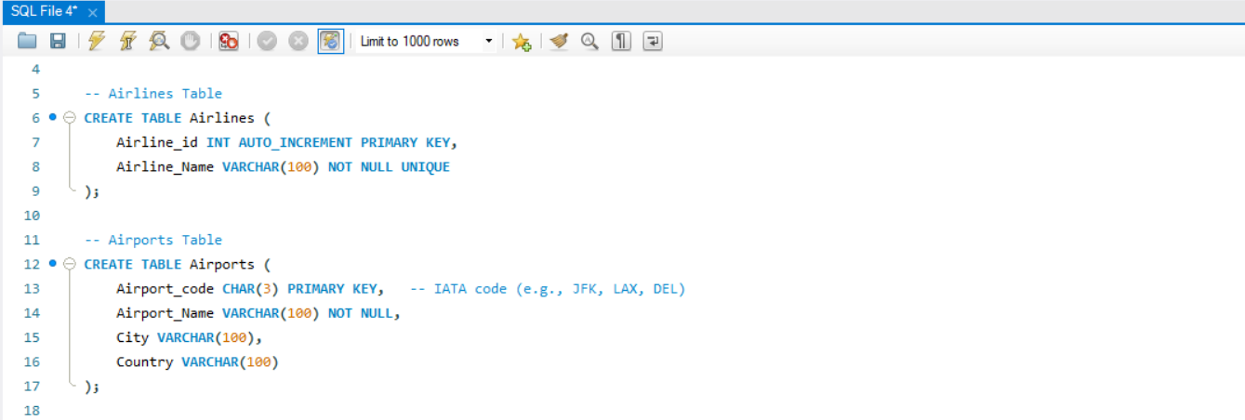
Creating Tables

Slide 6
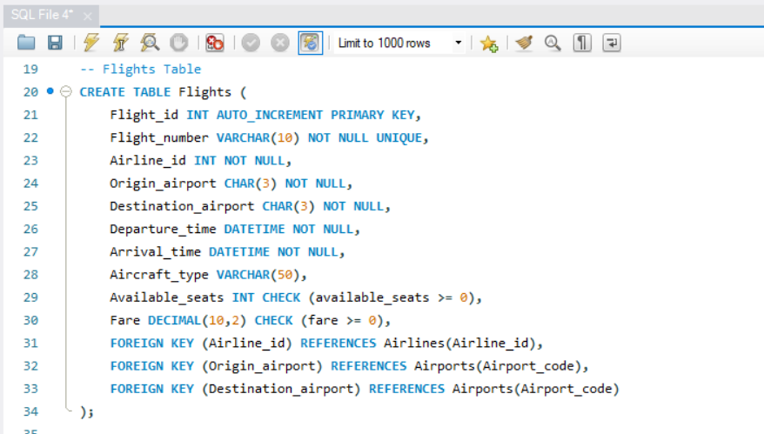
Creating Tables

Slide 7
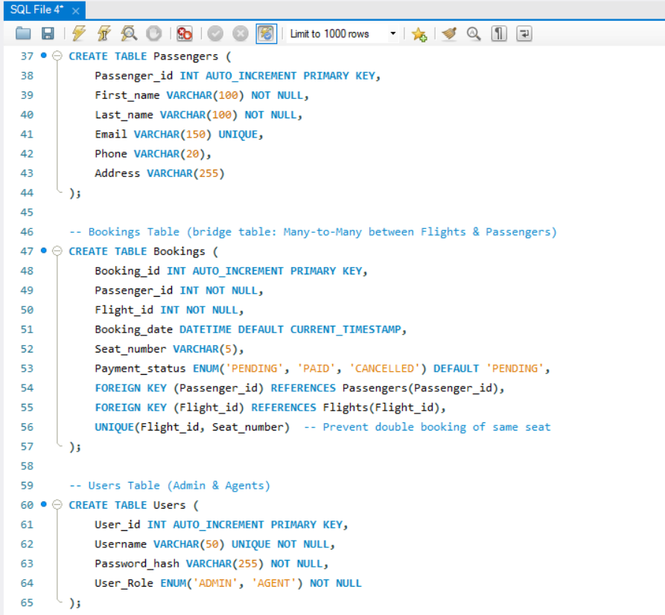
Creating Tables

Slide 8
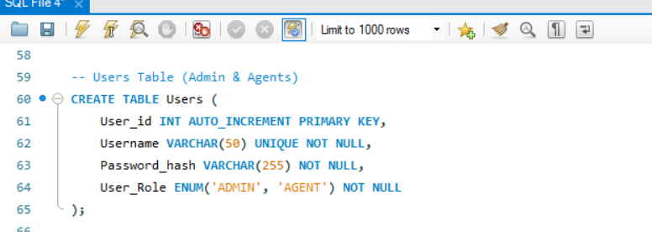
Creating Tables

Slide 9
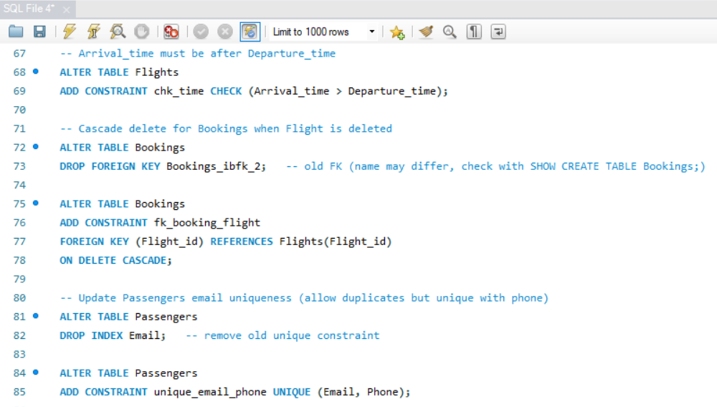
Alter Tables

Slide 10
Alter Table Actions

Slide 11
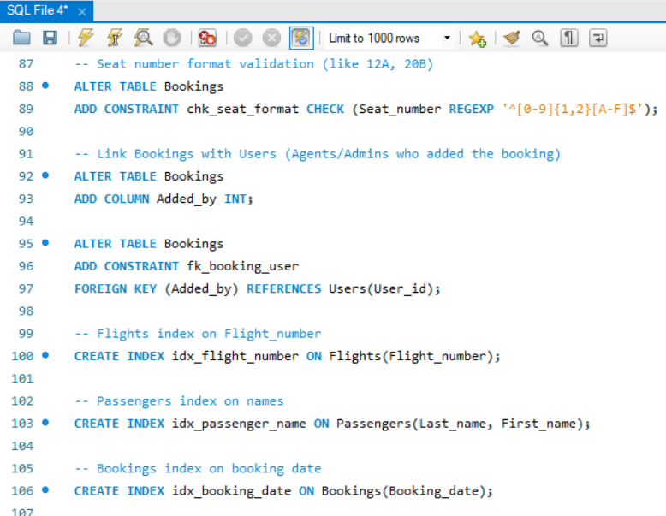
Alter Tables

Slide 12
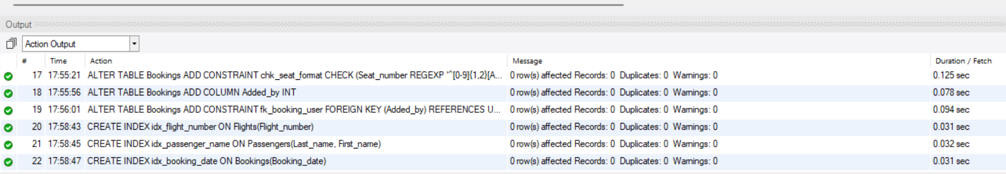
Alter Table Actions

Slide 13
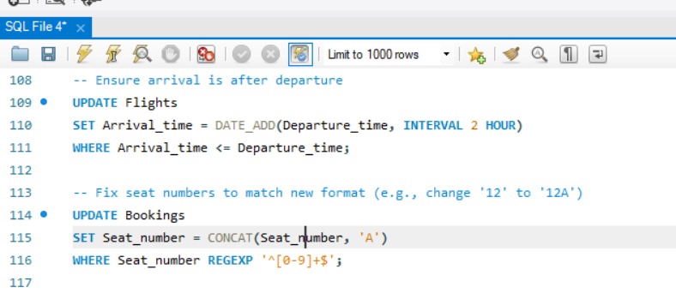
Alter Tables

Slide 14
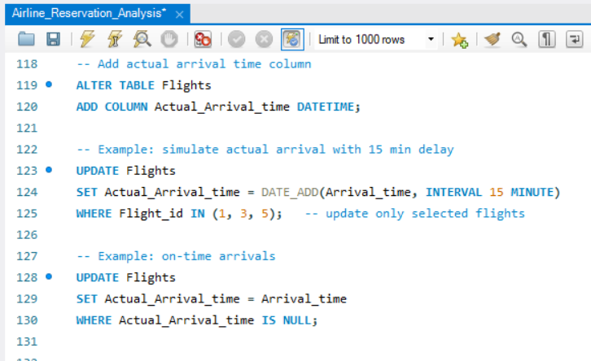
Alter Tables

Slide 15
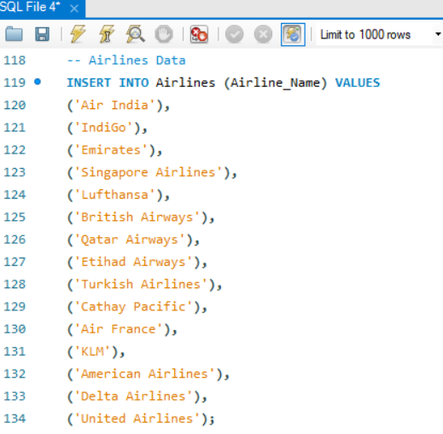
Inserting values

Slide 16
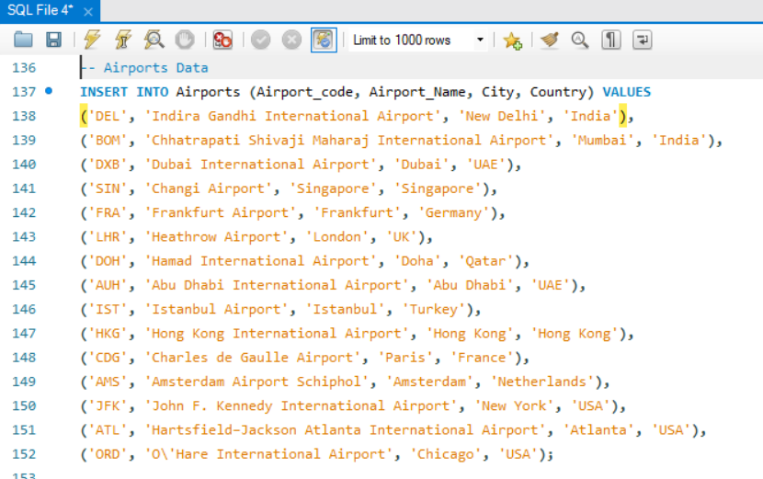
Inserting values

Slide 17
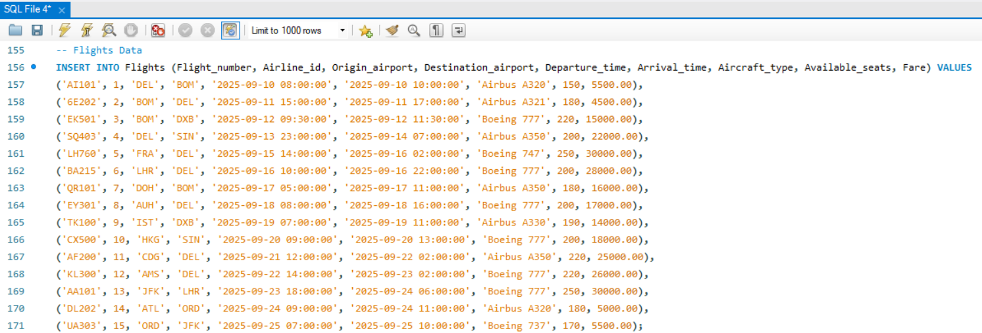
Inserting values

Slide 18
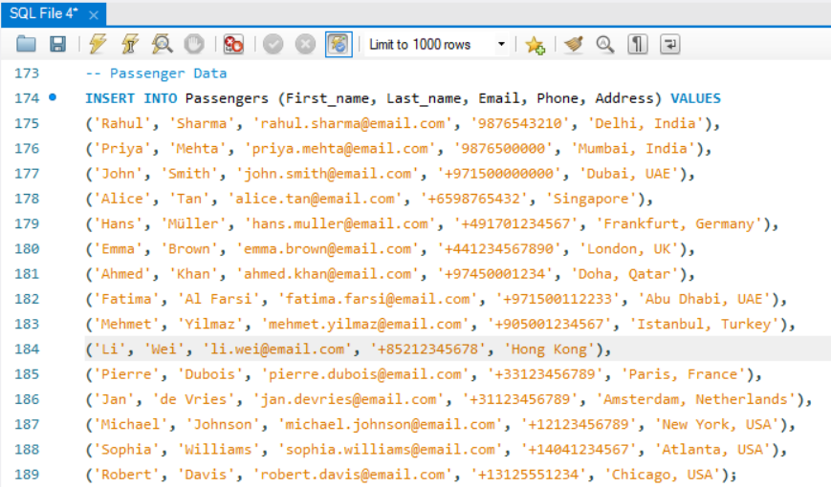
Inserting values

Slide 19
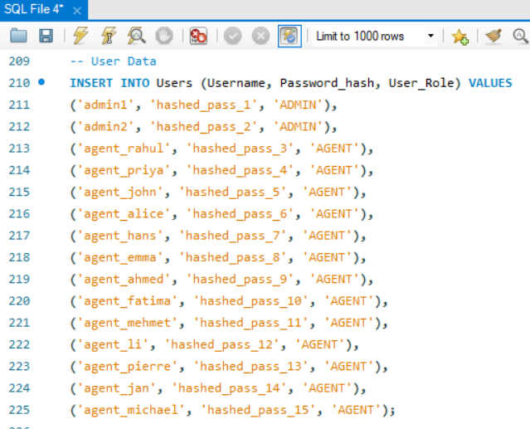
Inserting values

Slide 20
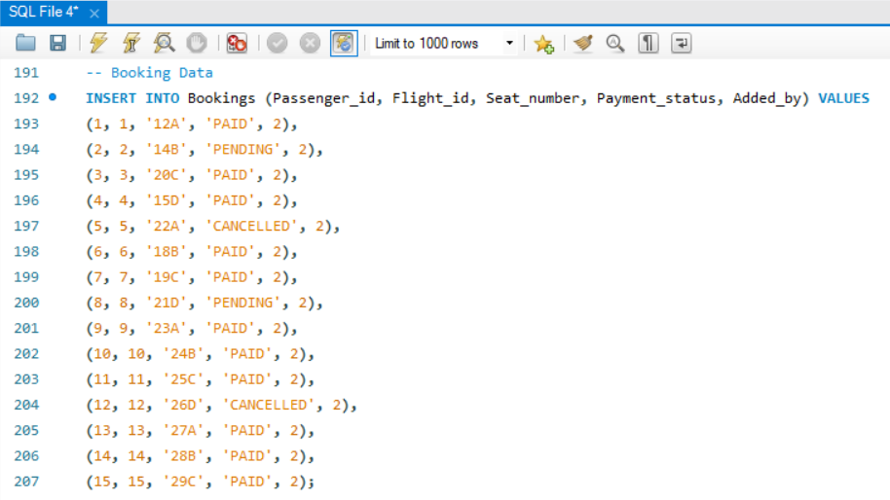
Inserting values

Slide 21
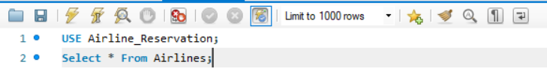
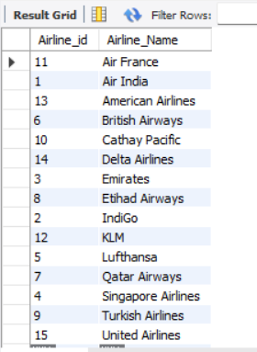
Selecting values

Slide 22
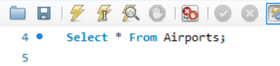
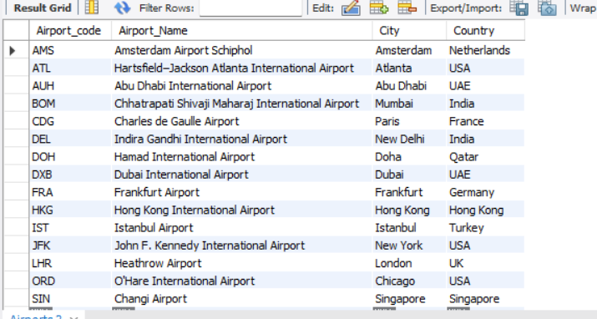
Selecting values

Slide 23

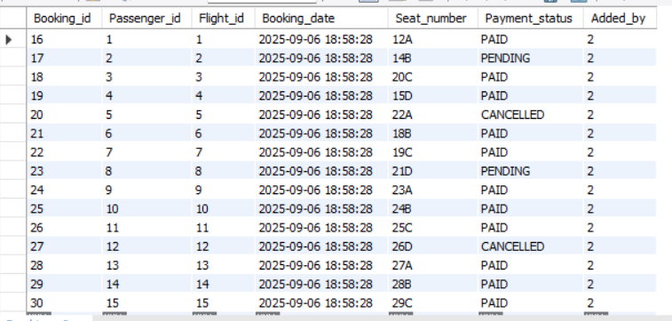
Selecting values

Slide 24
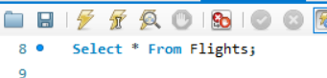
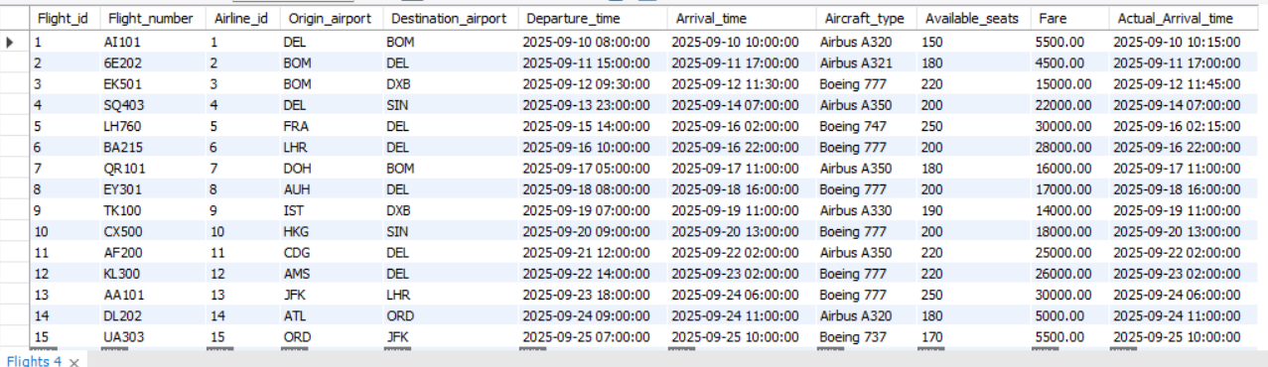
Selecting values

Slide 25
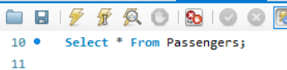
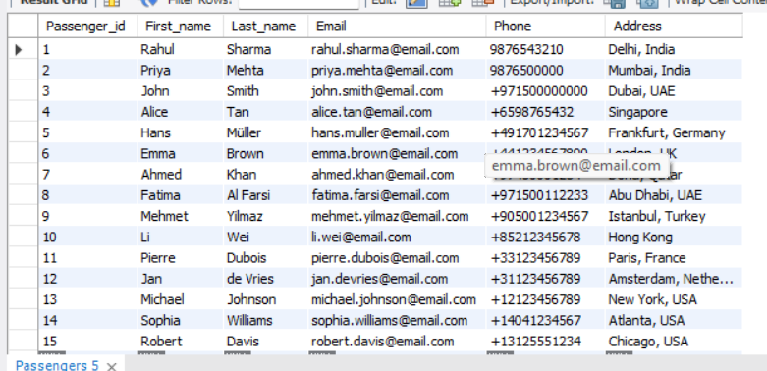
Selecting values

Slide 26
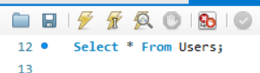
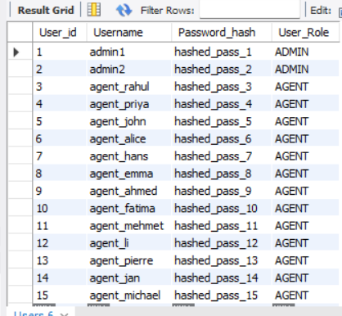
Selecting values

Slide 27
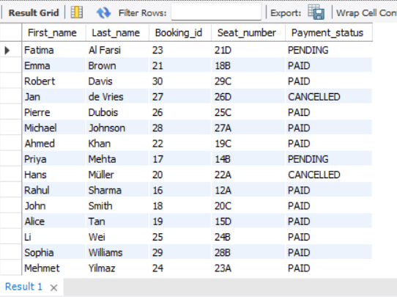
Query / Analysis
Q.1)Write a query to show all passengers and their bookings.
A.
SELECT p.First_name, p.Last_name, b.Booking_id, b.Seat_number, b.Payment_status
FROM Passengers p
JOIN Bookings b ON p.Passenger_id = b.Passenger_id;

Slide 28
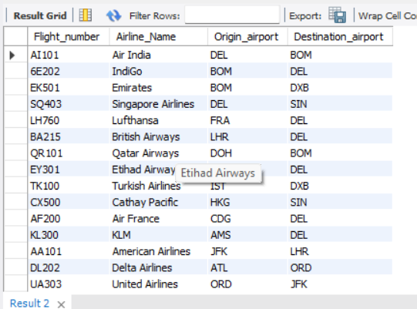
Query / Analysis
Q.2) Query list all flights with their airline name.
A.
SELECT f.Flight_number, a.Airline_Name, f.Origin_airport, f.Destination_airport
FROM Flights f
JOIN Airlines a
ON f.Airline_id = a.Airline_id;

Slide 29
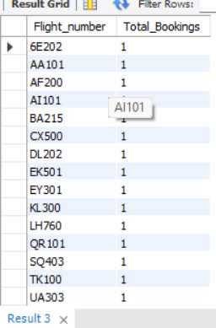
Query / Analysis
Q.3) Count the number of bookings for each flight.
A.
SELECT f.Flight_number, COUNT(b.Booking_id) AS Total_Bookings
FROM Flights f
LEFT JOIN Bookings b
ON f.Flight_id = b.Flight_id
GROUP BY f.Flight_number;

Slide 30
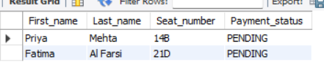
Query / Analysis
Q.4) Find passengers who have pending payments.
A.
SELECT p.First_name, p.Last_name, b.Seat_number, b.Payment_status
FROM Passengers p
JOIN Bookings b
ON p.Passenger_id = b.Passenger_id
WHERE b.Payment_status = 'PENDING';

Slide 31
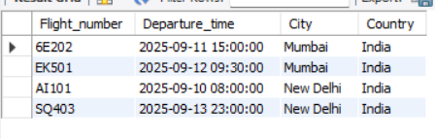
Query / Analysis
Q.5) Query list of flights departing from India
A.
SELECT f.Flight_number, f.Departure_time, ap.City, ap.Country
FROM Flights f
JOIN Airports ap
ON f.Origin_airport = ap.Airport_code
WHERE ap.Country = 'India';

Slide 32
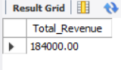
Query / Analysis
Q.6) Find the total revenue collected (only PAID bookings).
A.
SELECT SUM(f.Fare) AS Total_Revenue
FROM Bookings b
JOIN Flights f
ON b.Flight_id = f.Flight_id
WHERE b.Payment_status = 'PAID';

Slide 33
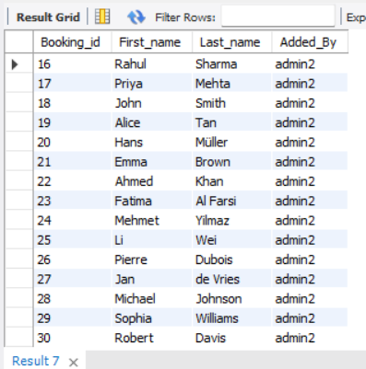
Query / Analysis
Q.7) Show which agent added each booking
A.
SELECT b.Booking_id, p.First_name, p.Last_name, u.Username AS Added_By
FROM Bookings b
JOIN Passengers p
ON b.Passenger_id = p.Passenger_id
JOIN Users u
ON b.Added_by = u.User_id;

Slide 34
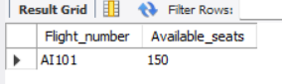
Query / Analysis
Q.8) Find flights with available seats less than 170.
A.
SELECT Flight_number, Available_seats
FROM Flights WHERE Available_seats < 170;

Slide 35
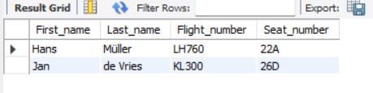
Query / Analysis
Q.9) Show all cancelled bookings with Passenger_name.
A.
SELECT p.First_name, p.Last_name, f.Flight_number, b.Seat_number
FROM Bookings b
JOIN Passengers p ON b.Passenger_id = p.Passenger_id
JOIN Flights f
ON b.Flight_id = f.Flight_id
WHERE b.Payment_status = 'CANCELLED';

Slide 36
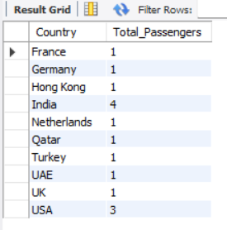
Query / Analysis
Q.10) Count number of passengers from each Country.
A.
SELECT ap.Country, COUNT(DISTINCT p.Passenger_id) AS Total_Passengers
FROM Passengers p
JOIN Bookings b
ON p.Passenger_id = b.Passenger_id
JOIN Flights f
ON b.Flight_id = f.Flight_id
JOIN Airports ap
ON f.Origin_airport = ap.Airport_code
GROUP BY ap.Country;

Slide 37
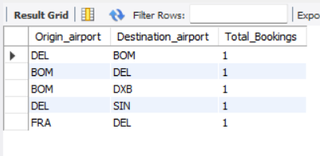
Query / Analysis
Q.11) Business Problem: Management wants to know which routes (origin → destination) have the highest passenger bookings to plan new flights.
A.
SELECT f.Origin_airport, f.Destination_airport, COUNT(b.Booking_id) AS Total_Bookings
FROM Bookings b
JOIN Flights f
ON b.Flight_id = f.Flight_id
GROUP BY f.Origin_airport, f.Destination_airport
ORDER BY Total_Bookings DESC
LIMIT 5;

Slide 38
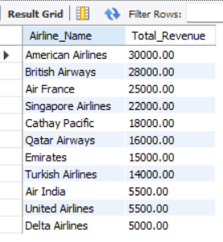
Query / Analysis
Q.12) Business Problem: Airlines want to track their revenue from ticket sales.
A.
SELECT a.Airline_Name, SUM(f.Fare) AS Total_Revenue
FROM Flights f
JOIN Airlines a
ON f.Airline_id = a.Airline_id
JOIN Bookings b
ON f.Flight_id = b.Flight_id
WHERE b.Payment_status = 'PAID’
GROUP BY a.Airline_Name
ORDER BY Total_Revenue DESC;

Slide 39
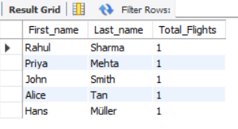
Query / Analysis
Q.13) Business Problem: Identify passengers who book the most flights in a year (loyalty program).
A.
SELECT p.First_name, p.Last_name, COUNT(b.Booking_id) AS Total_Flights
FROM Passengers p
JOIN Bookings b ON p.Passenger_id = b.Passenger_id
WHERE b.Booking_date >= DATE_SUB(CURDATE(), INTERVAL 1 YEAR)
GROUP BY p.Passenger_id
ORDER BY Total_Flights DESC
LIMIT 5;

Slide 40
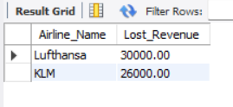
Query / Analysis
Q.14) Business Problem: How much potential revenue is lost due to cancellations?
A.
SELECT a.Airline_Name, SUM(f.Fare) AS Lost_Revenue
FROM Bookings b
JOIN Flights f ON b.Flight_id = f.Flight_id
JOIN Airlines a ON f.Airline_id = a.Airline_id
WHERE b.Payment_status = 'CANCELLED'
GROUP BY a.Airline_Name
ORDER BY Lost_Revenue DESC;

Slide 41
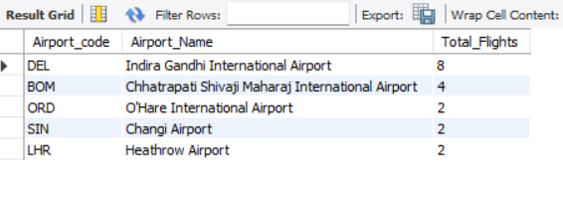
Query / Analysis
Q.15) Business Problem: Find the airports with the most flights (departures + arrivals).
A.
SSELECT ap.Airport_code, ap.Airport_Name, COUNT(*) AS Total_Flights
FROM Airports ap
JOIN (
SELECT Origin_airport AS Airport_code FROM Flights
UNION ALL
SELECT Destination_airport AS Airport_code FROM Flights) AS fd
ON ap.Airport_code = fd.Airport_code
GROUP BY ap.Airport_code, ap.Airport_Name
ORDER BY Total_Flights DESC
LIMIT 5;

Slide 42
Thank You

